Slide 1

RoboCup@Home Final Project
Xingcheng Zhou, Zeen Song, Xiajun Zhou
Technical University of Munich
TUM Department of Electrical and Computer Engineering
Chair of Institute Cognitive System
Munich, Feb.2020

Slide 2
Hand me that
The operator raise hand point one object on the table
Tiago recognize the object and ask for confirmation
Tiago go to the table and grab it

Slide 3
Attemps
1. Self-trained Deep Neural Network
2. Openpose Package

Slide 4
Self-trained Deep Neural Network
Judge position of the operator’s arm depend on a self-trained DNN.
Communicate with operator for confirmation the direction(left or right table)
Navigate to the confirmed location and detect objects.
Ask operator questions to determine the wanted object e.g. bottle
Grasp the wanted object

Slide 5
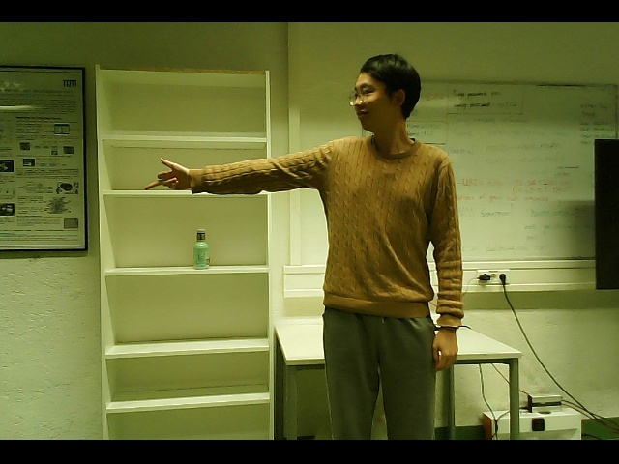
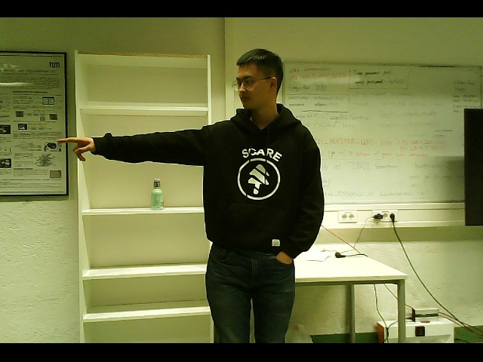
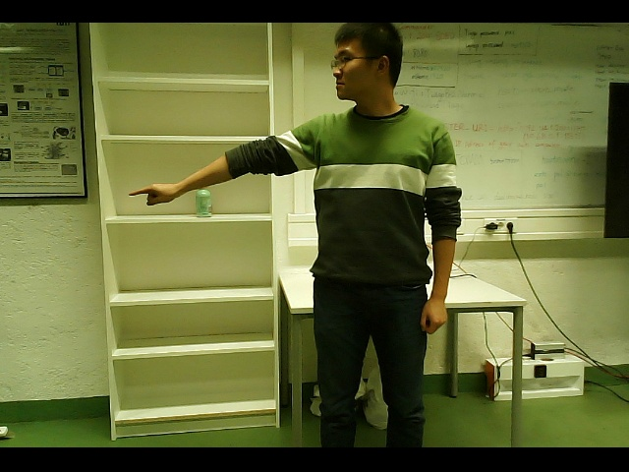
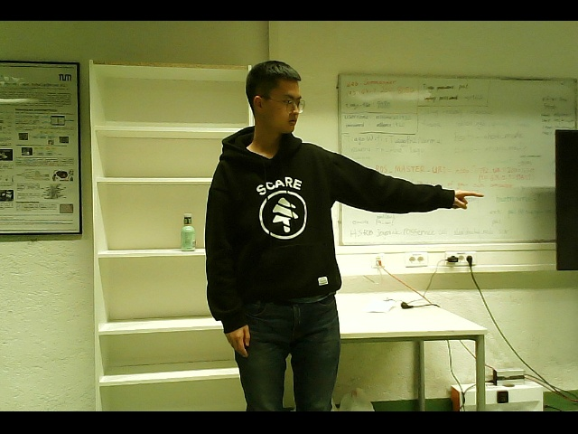
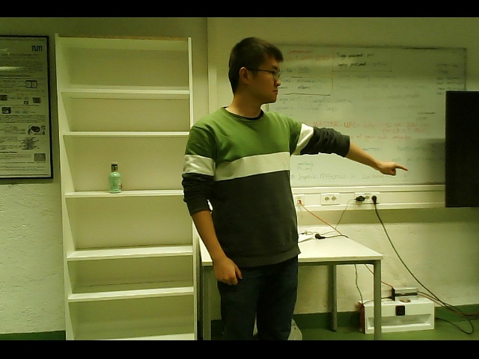
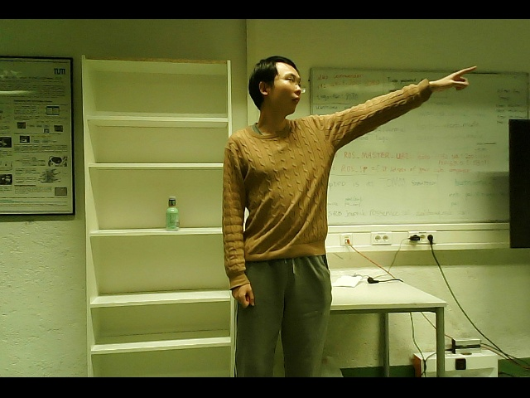
Step 1. Training Data and Validation Data for Deep Neural Network
Recording with Rosbag file and split in frames.
RIGHT
LEFT
About 2500 right
About 2500 left

Slide 6
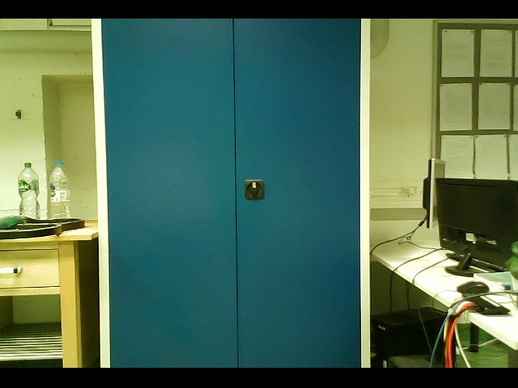
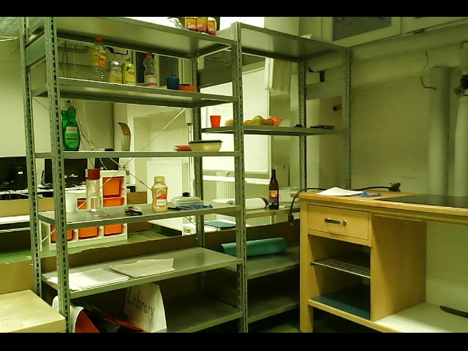
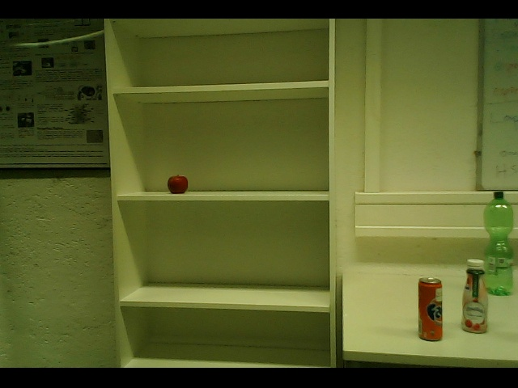
Step 1. Training Data and Validation Data for Deep Neural Network
Empty
About 3000 empty

Slide 7
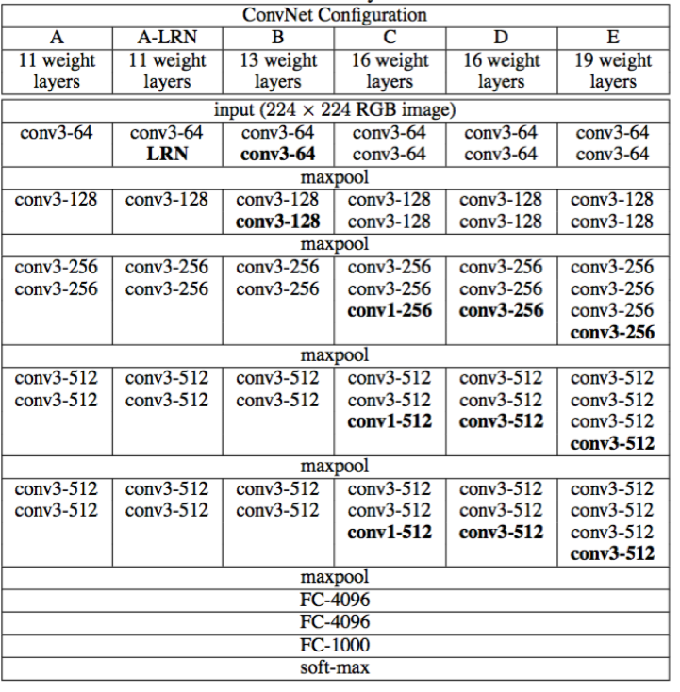
Step 1. Structure for Deep Neural Network
Similar tasks: Image Classifications
Fig1: 5 VGG Deep Neural Network structures

Slide 8

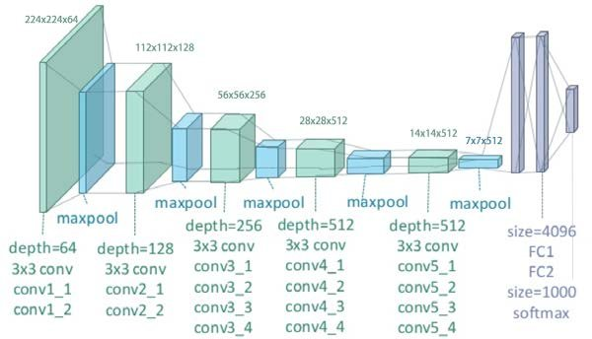
First Try VGG-16 and VGG-19
Result: Test Result is bad
About 40% correctly judged
Result: Test Result is bad too
About 50% correctly judged

Slide 9
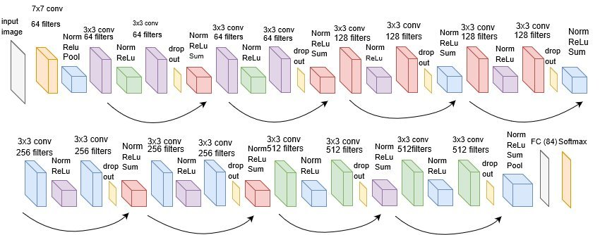
Second Try Resnet-18
Result: Better Test Result, About 70% correctly judged

Slide 10
Openpose package ROS
Read 25 2D coordinates of the operator’s body by Openpose
Read the coordinates of objects on the table by Darknet YOLO V3
Select the 3 points on the right arm and do linear regression
Calculate the distances between object-coordinates and the line
Choose the object with the smallest distance and ask operator for confirmation
If denied, keep asking for confirmation. If confirmed, navigate to the table and grasp the object.
Hold the object in a safe position and go to operator side.

Slide 11
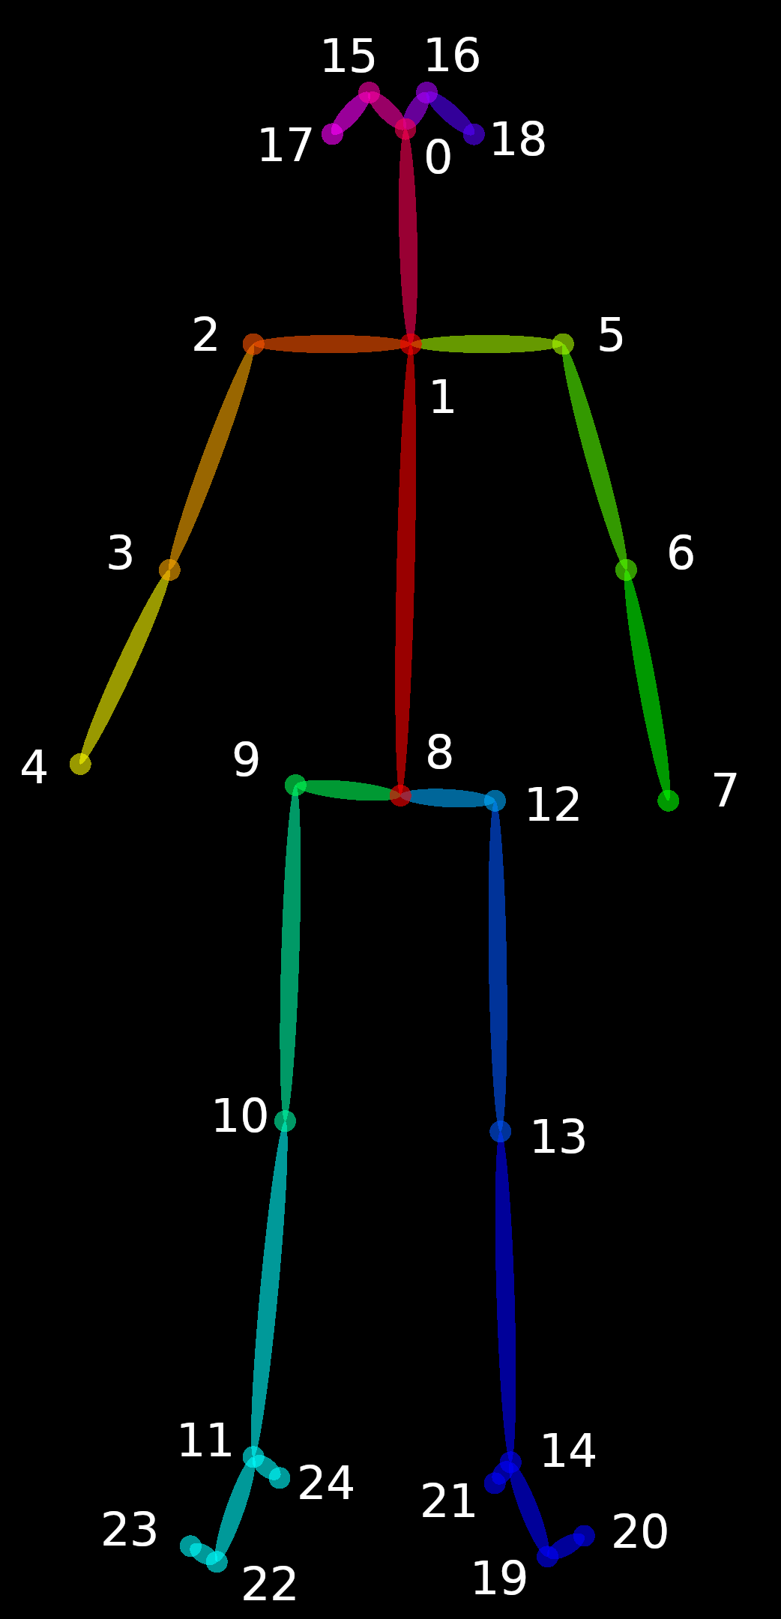
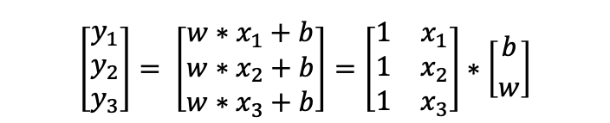
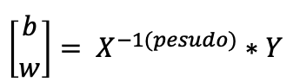
Step 1. Coordinates reading
Read the 2D coordinates of points 2, 3 and 4
Do Linear Regression with these 3 points
$$\left[\begin{matrix}y_{1} \\ y_{2} \\ y_{3}\end{matrix}\right]= \left[\begin{matrix}w∗x_{1}+b \\ w∗x_{2}+b \\ w∗x_{3}+b\end{matrix}\right]=\left[\begin{matrix}1 & x_{1} \\ 1 & x_{2} \\ 1 & x_{3}\end{matrix}\right]∗\left[{b \atop w}\right]$$
$$\left[{b \atop w}\right]= X^{−1(pesudo)}∗Y$$
Pose Output Format (BODY_25)

Slide 12
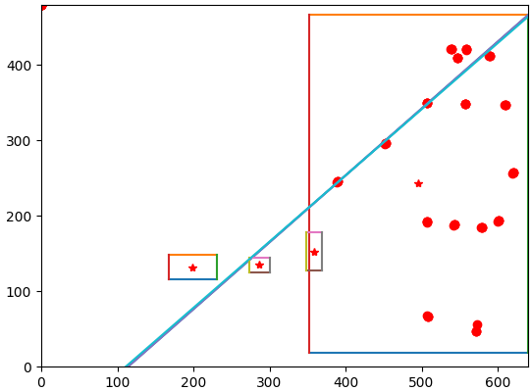
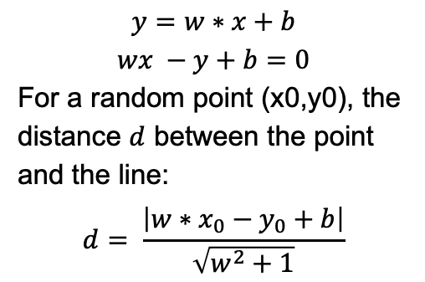
Step 2. Choose the wanted object
$$y=w∗x+b$$
$$wx −y+b=0$$
For a random point (x0,y0), the distance $d$ between the point and the line:
$$d= \frac{\left|w∗x_{0}−y_{0}+b\right|}{\sqrt{w^{2}+1}}$$

Slide 13
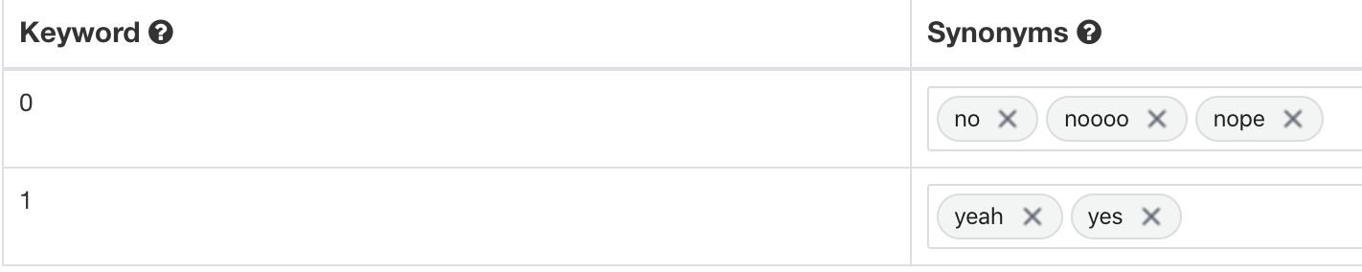
Step 3. Confirm with Wit.ai
Online programming
Call rosservice Wit (ListenAndInterpret)
If Yes, go to corresponding Point
If No, return to keep asking

Slide 14
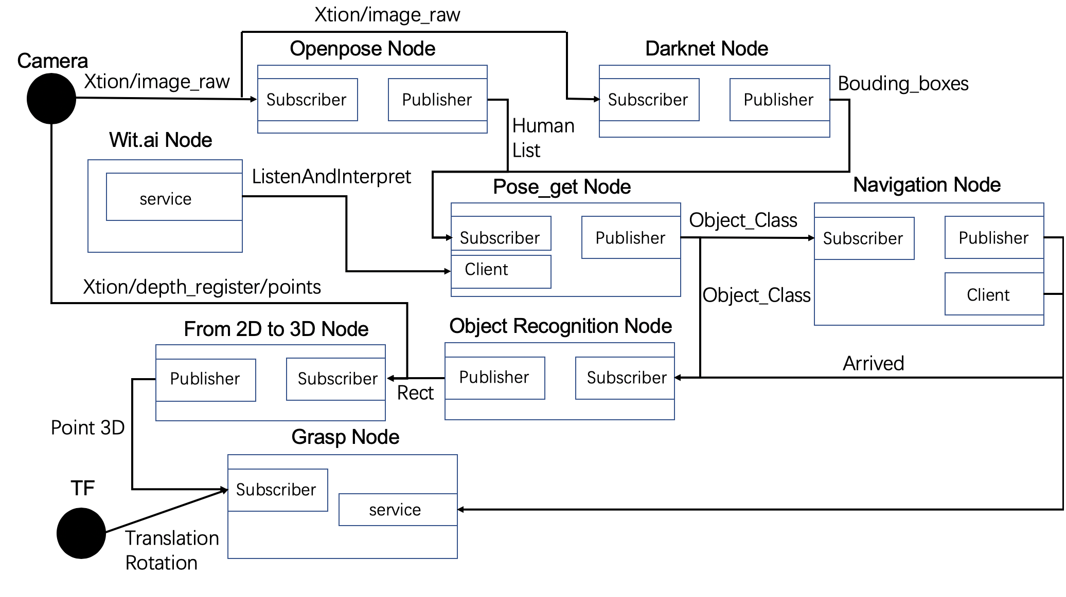
Communication logic

Slide 15
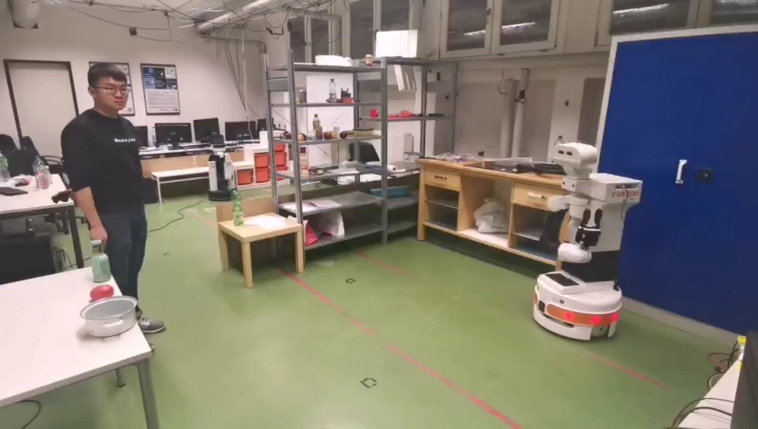
Step 4. Navigation and Grasp
First scan the laboratory map
Localization, navigation and grasp are same like the tutorial tasks

Slide 16
Thank you for your attention

